Slide 1

Cultural Responsiveness, Anti-Racism, and Equity in School Mental Health
Creating spaces for where everyone is heard, understood, and supported to be their best selves

Slide 2
In our time together we will
(a presentation in two parts)
Discuss
Discuss Nichol’s Philosophical Aspects of Cultural Difference and how understanding the axiology, epistemology, logic and process aids in providing culturally responsive care.
Increase
Increase our understanding of historical community trauma, race-based traumatic stress (RBTS) and its effects on students and families.
Discuss
Discuss the Social Determinants of health and the impact they have on our students and families.
Discuss
Discuss what culturally responsive, anti racist practice looks like in action.
Increase
Increase our understanding of what is required to do this work authentically.
Provide
Provide resources for increasing knowledge and skill development.
Part two
Notes:
Culturally Responsive Practice-Culturally responsive practices are approaches in which students’ cultural strengths and identities are used as assets for developing social emotional and academic skills that promote school and life success. These practices support students’ academic achievement and sense of well-being by affirming their cultural place in the world. Culturally responsive practices are intentional in critically examining power and privilege, implicit biases, and institutional racism, which serve as barriers to realizing the full potential of transformative social emotional learning (SEL) practices. - Washington SEL Implementation Brief: Focus on Culturally Responsive Practices
Anti Racist Practice- Anti-racism is a process of actively identifying and opposing racism. The goal of anti-racism is to challenge racism and actively change the policies, behaviors, and beliefs that perpetuate racist ideas and actions. In the context of behavioral health and education, Anti Racist practices are those practices that

Slide 4
Historical Context
The word '''Maafa''' (also known as the African Holocaust) is derived from a Kiswahili word meaning disaster, terrible occurrence or great tragedy. Dr. Marimba Ani introduced it into contemporary African American scholarship as a preferred reference to the period in world history, identified as the Middle Passage or Transatlantic Slave Trade.
The term today collectively refers to the Pan-African discourse of the 500 hundred years of suffering of people of African heritage through Slavery, imperialism, colonialism, apartheid, rape, invasions, and exploitation continued through other forms of oppression to the present day.

Slide 5
The Journey to African American Citizenship…
A Dream Deferred.
1619-2022
1619-1865 Chattel Slavery
  246 Years
1865-1965 Jim Crow and Segregation
  100 Years
  No Rights (in the south) Limited Rights (In the north)
Citizenship Rights
  57 Years
  The Struggle continues for full inclusion
403 YEARS
Notes:
Welfare rules “no adult men in the home”
Exodus of manufacturing jobs and middle class
Drugs, crime and family disintegration (all inter-
related) took a heavy toll on the inhabitants.
Urban renewal (1949-1975): highways built
directly through Black communities
Hyper-ghetto extreme concentration of poverty.
Mass incarceration: Blacks and whites use and sell drugs at about the same rate, but blacks were 20 times more likely going to Jail.
Crack cocaine: impact on women and children.
Gang violence and concentrated police
presents
Individuals born in middle 1980's or drug “Crack” Era
until now.
These generations has been enriched with services providers external to family members. Furthering an inferiority and dependent mentality.
These individuals have developed elements of internalized oppression and extreme level of learned helplessness.

Slide 6
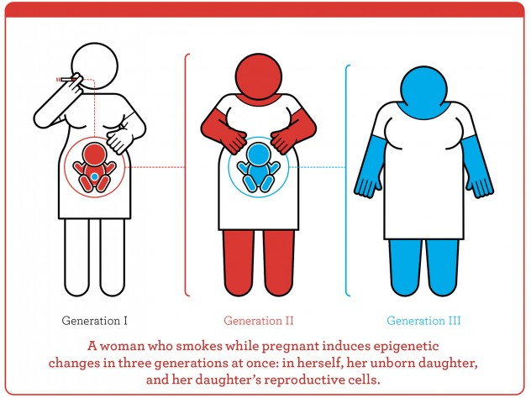
Basically, epigenetics studies how the experiences of our ancestors can alter how our DNA expresses itself. Which switches are turned on and off.

Slide 7
"People are trapped in history,
and history is trapped in them.“
-James Baldwin

Slide 8

Social Determinants Of Health
Social determinants of health (SDOH) are the conditions in the environments where people are born, live, learn, work, play, worship, and age that affect a wide range of health, functioning, and quality-of-life outcomes and risks.

Slide 9
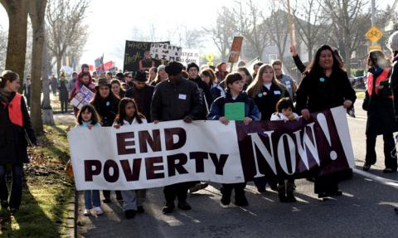
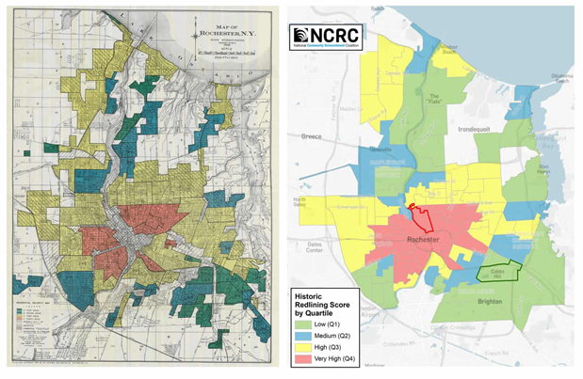

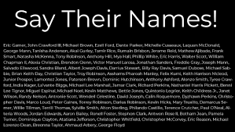
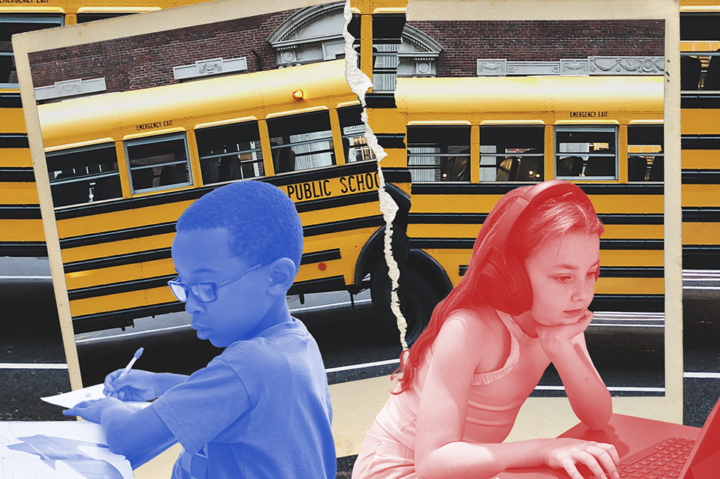
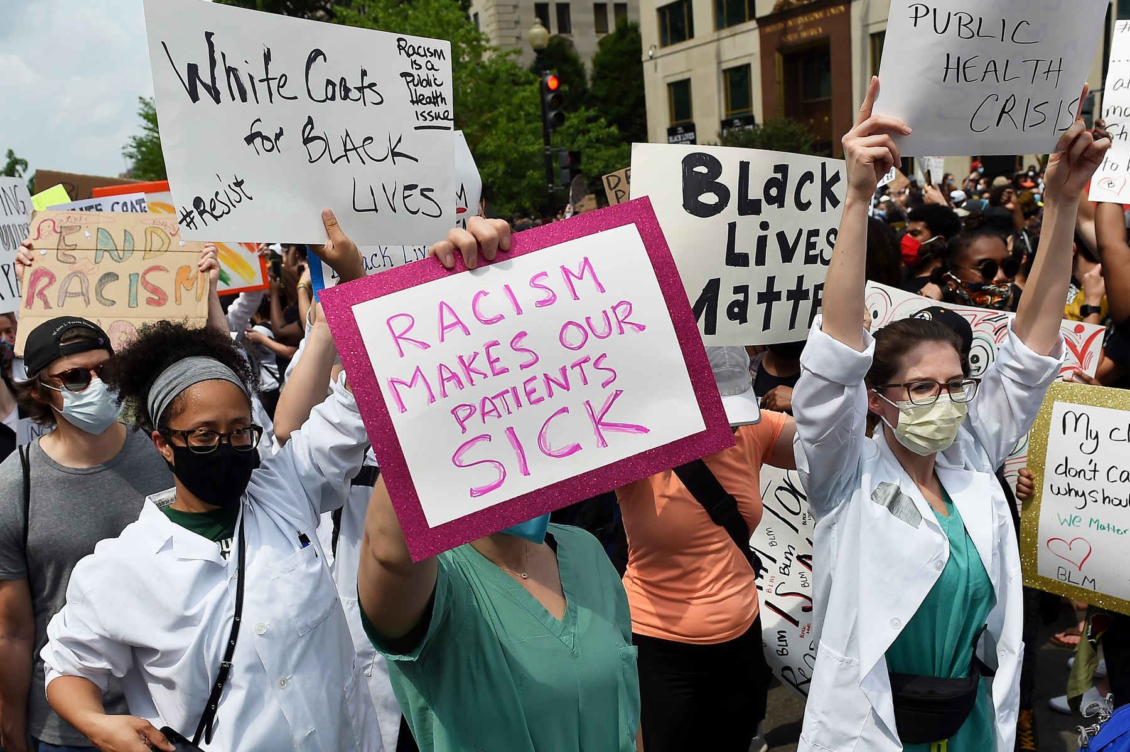
57 Years: The Struggle for full inclusion
Redlining
Health Disparities
Educational Inequality
Income Inequality
Concentrated Poverty
Food Deserts
Mass Incarceration
Racialized trauma
Notes:
56 Years since the passing of the civil rights act;

Slide 10

Risk Factors Are Not Predictive Factors Because of Protective Factors
Dr. Carl C. Bell

