Slide 1
Welcome to Project ECHO!
Strengthening Educators’ Response to the Mental Health Needs of Teens
Hosted by the Expanded School Mental Health Team at UR Medicine
www.URSOS.org

Slide 2
Introductions (5 min)
Notes:
Also put name, school, & title in chat

Slide 3
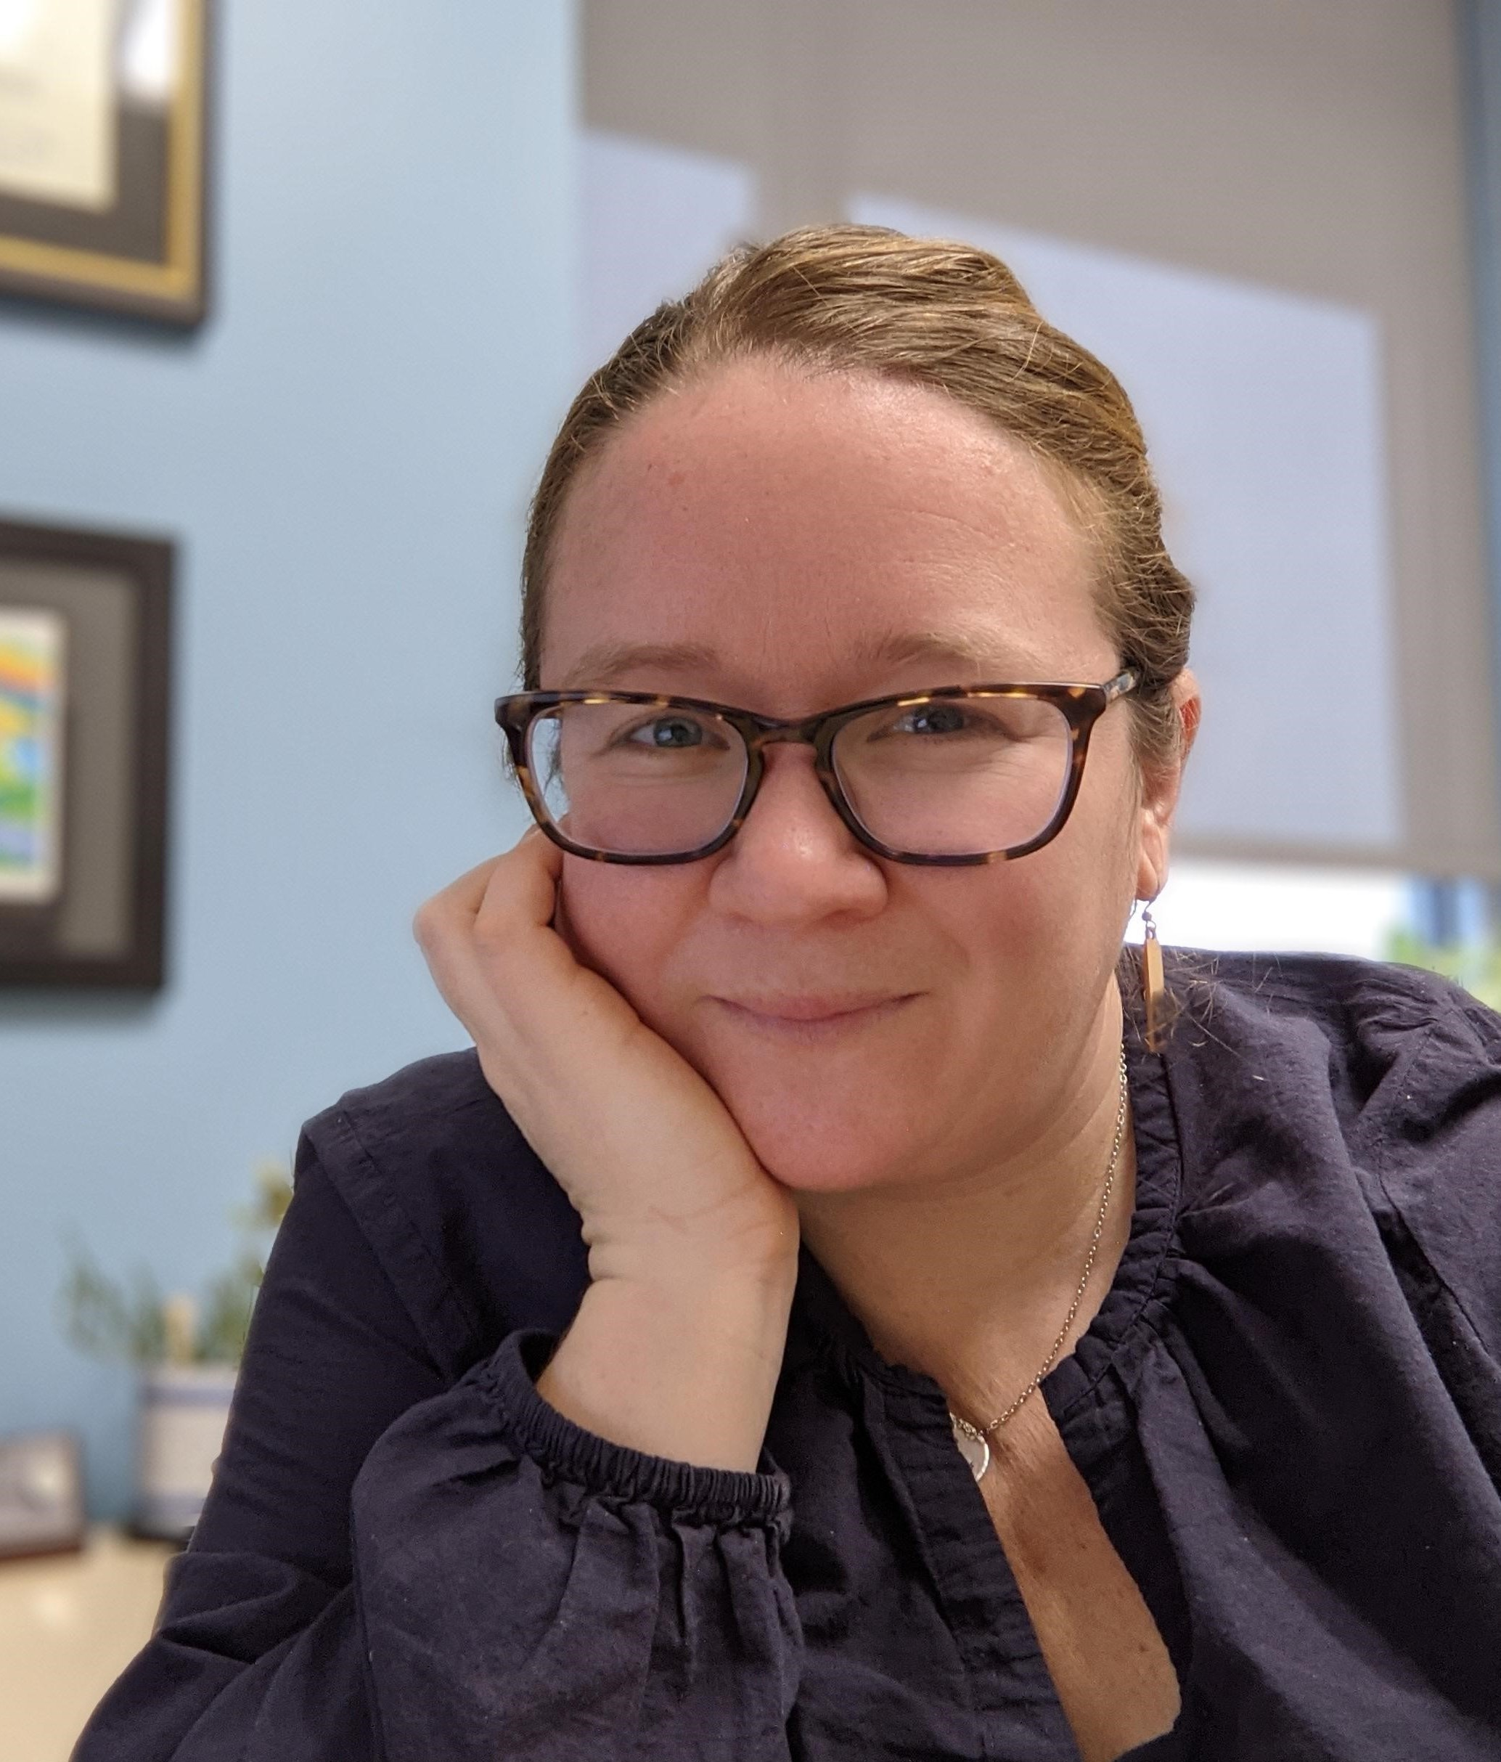
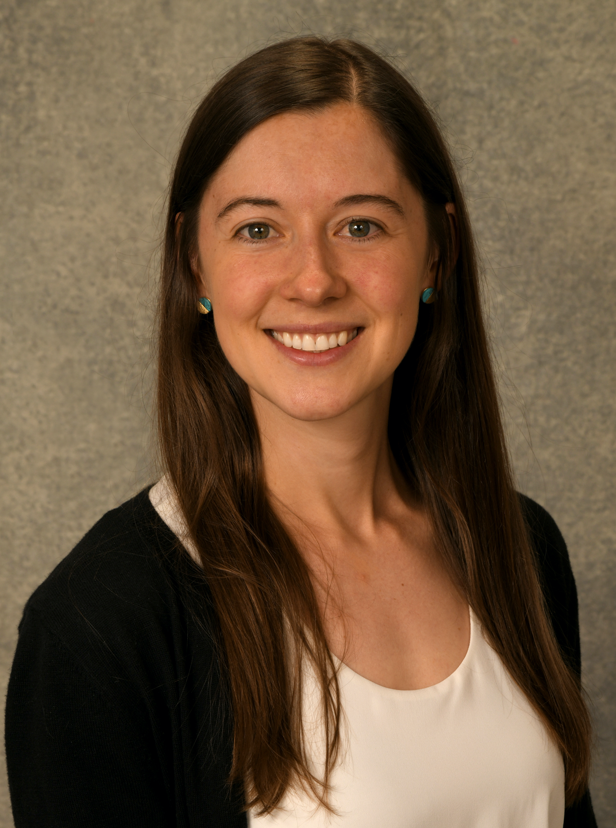
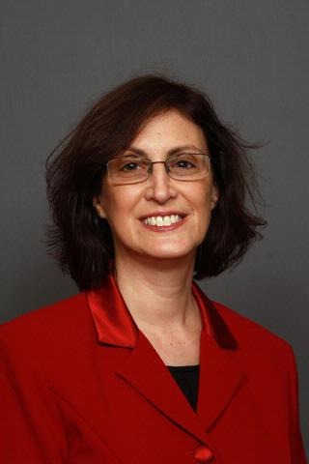
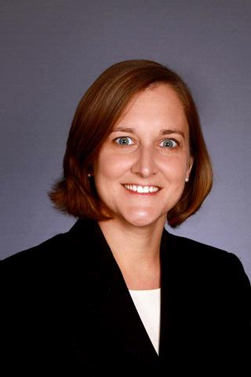
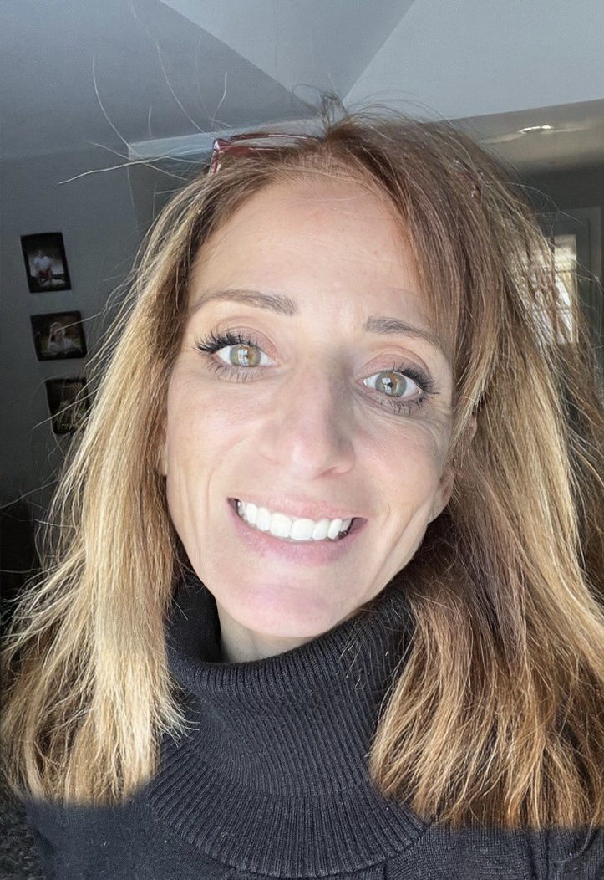
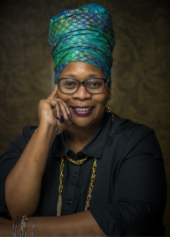
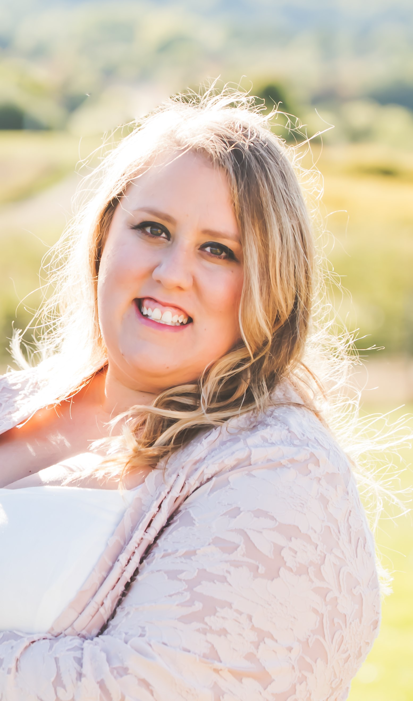
www.ursos.org
Welcome From Our Hub Team!
Melissa Heatly, Ph.D.
Project Director
Proj. ECHO Lead
Allison Stiles, Ph.D.
Co-Director
YMHFA Lead
Linda Alpert-
Gillis, Ph.D.
Senior Advisor
Corey Nichols-Hadeed, JD
Project Coordinator
Jerard Johnson
Case Management
Kristen DiFillippo
Parent Liason
Melanie Funchess
Ubuntu Village Works, LLC
Jessica Watington
Office of Mental Health

Slide 4
No disclosures or relevant financial relationships to declare

Slide 5
ECHO Session Training Surveys
We ask that you please complete a very brief survey at the end of each ECHO session. Please note that you cannot receive continuing educator hours unless you complete this survey.
ECHO Session #1 Training Survey: https://redcap.link/ECHO-1
University of Rochester Medical Center, Center for Experiential Learning is recognized by the New York State Education Department's State Board for Social Work as an approved provider of continuing education for licensed social workers #SW-0005. This activity is approved for 1.0 Social Work continuing education hour(s).
University of Rochester Warner School of Education is recognized by the New York State Education Department as an approved provider of Continuing Teacher Leader Education (CTLE) for educators, administrators, and some classes of paraprofessionals. This activity is approved for 1.0 Continuing Teacher Leader Education hours.

Slide 6
UR-SOS Announcements
Monthly ECHO Meetings: 2nd & 4th Thursdays, 11am-12pm via zoom
YMHFA Instructors:
3-day YMHFA Instructor Certification Course:
January 18th, 19th, and 20th (approx. timing is 8:30am-4:30pm)
Monthly 30-minute Implementation Trainings (3rd week of each month)
Exact day/time = TBD; please email Allison Stiles (allison_stiles@urmc.rochester.edu) to indicate availability
Wednesdays from 11-11:30am ​ (optional office hours from 11:30am-12pm)
Wednesdays from 12-12:30pm (optional office hours from 12:30pm-1pm)
Thursdays from 11-11:30am (optional office hours from 11:30am-12pm)
Thursdays from 12-12:30pm (optional office hours from 12:30pm-1pm)

Slide 7
Introduction to UR-SOS Project: Recognizing & Supporting Youth in Distress in Educational Settings
Didactics (15 minutes)
Dr. Allison Stiles
Child & Adolescent Psychologist
at UR Medicine

Slide 8
Prevalence of Teen MH Challenges
From 2009 to 2019…
the proportion of high school students reporting persistent feelings of sadness or hopelessness increased by 40%
The share seriously considering attempting suicide increased by 36%
The share creating a suicide plan increased by 44%.
Suicide rates among youth ages 10-24 in the US increased by 57%.
Since the pandemic began…
Depressive and anxiety symptoms doubled during the pandemic, with 25% of youth experiencing depressive symptoms and 20% experiencing anxiety symptoms.
Negative emotions or behaviors such as impulsivity and irritability—associated with conditions such as ADHD— appear to have moderately increased.
Early estimates from the National Center for Health Statistics suggest there were more than 6,600 deaths by suicide among the 10-24 age group in 2020. 2021 ED visits for suicide attempts were 51% higher for teen girls, and 4% higher for teen boys than in 2019.
Notes:
Very brief overview

Slide 9
Challenges in Recognizing Youth in Need of Support
Stigma around discussing and disclosing mental health challenges
Externalizing and high-flying behaviors much easier to ‘see’ than internalizing difficulties, like depression or anxiety
Front-line educators not always aware of ways to recognize signs that teens may be developing mental health problems
“Terrifying shortage of mental health providers and counselors in schools right now.” – Ed Weekly

Slide 10
Urgent Need for . . . .
Easy & Efficient methods of . . .
Early identification of youth with emerging MH challenges
Monitoring kids with internalizing concerns
Assessing immediate risk of suicidality and self-harm
Resources for talking with families about concerns
Resources for linking families with resources & services
Strategies for implementation

Slide 11
UR-Supporting Our Students Goal: Enhance the capacity of middle and high school educators within the NY Finger Lakes region to recognize, support, and refer teens with serious behavioral health needs
www.ursos.org
Notes:
UR-SOS as a tool & resource for addressing this urgent need
The goal of URSOS, therefore, is to strengthen the ability of middle and high school educators across the Finger Lakes region to learn how to recognize and respond to teens with serious behavioral health needs

Slide 12
www.ursos.org
Expert Training &
Case Consultation
Develop District
YMHFA Trainers
School-Based Referrals to
Short-Term Intervention Services
Adolescent Mental Health
Tools & Community Resources
Notes:
Each of the project’s four components that I’ll discuss are connected;
The members of your UR-SOS team will be participating in Project ECHO, 1 member of your UR-SOS team will become trained as a YMHFA instructor and will provide subsequent YMHFA trainings to your district – allowing for far reaching and sustainable capacity-building in your district
Your district will also have access to our new school-based referral stream to short-term intervention services,
and the district will also gain access to tools and resources for supporting youth mental health.
Discuss how each component is interdependent

Slide 13
UR-SOS Website:
Houses all information related core components of the project
ECHO recordings, slides & resources
Up-to-date tools & community resources for supporting teen mental health
Links for referral to UR Medicine Short-Term Intervention Services (READY & START)
→ www.URSOS.org
Notes:
-go to website- walk through core components of our project, which are on our website

Slide 14
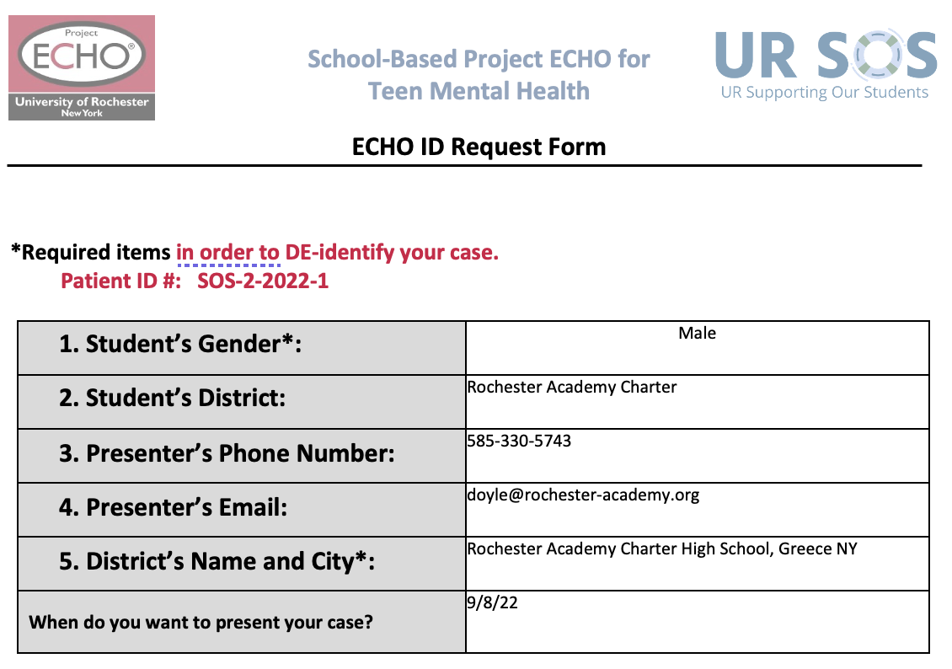
Case Presentation:
How can we better connect the student to the school community & help him engage in school work?
With so many concerns, where should our school team focus our attention & how?
What options for support can our school teams connect this student and family with?

Slide 15
ECHO Session Training Surveys & Continuing Education Reminder
We ask that you please complete a very brief survey at the end of each ECHO session. Please note that you cannot receive continuing educator hours unless you complete this survey.
ECHO Session #1 Training Survey: https://redcap.link/ECHO-1
University of Rochester Medical Center, Center for Experiential Learning is recognized by the New York State Education Department's State Board for Social Work as an approved provider of continuing education for licensed social workers #SW-0005. This activity is approved for 1.0 Social Work continuing education hour(s).
University of Rochester Warner School of Education is recognized by the New York State Education Department as an approved provider of Continuing Teacher Leader Education (CTLE) for educators, administrators, and some classes of paraprofessionals. This activity is approved for 1.0 Continuing Teacher Leader Education hours.

Slide 16
Next Time
Approaching & Supporting Youth and Families in Distress
Training will offer education in understanding adolescents’ Cycle of Regulation and explicit guidance for verbal de-escalation strategies including non-verbal body language and active listening skills.
Linda Alpert-
Gillis, Ph.D.
Child & Adolescent Psychologist

Slide 17
Welcome to Project ECHO!
Strengthening Educators’ Response to the Mental Health Needs of Teens
Hosted by the Expanded School Mental Health Team at UR Medicine
www.URSOS.org

