Slide 1


PARENTING IN THE SCREEN AGE BUILDING STRATEGIES FOR YOUR CHILD’S DIGITAL WELLBEING

Slide 2
“Children need a great deal of free play to thrive. It’s an imperative that’s evident across all mammal species… Hundreds of studies on young rats, monkeys, and humans show that young mammals want to play, need to play, and come out socially, cognitively, and emotionally impaired when they are deprived of play.”
–Jonathan Haidt, the Anxious Generation

Slide 3

The Decline of Free-Play
What would happen if two 10-year-olds played in a local park without adults around?
60% report children would likely to get injured.
50% thought they would likely get abducted.
(Harris Poll, 2025)
These intuitions don’t even begin to resemble reality.
Notes:
Parents were asked on a Harris Poll in 2025: What would happen if two 10-year-olds played in a local park without adults around?
60% report children would likely to get injured.
50% thought they would likely get abducted.
However, kidnapping in the United States is so rare that a child would have to be outside unsupervised for, on average, 750,000 years before being snatched by a stranger.
Parents know their neighborhoods best, of course, and should assess them carefully.
The tendency to overestimate risk comes with its own danger. Without real-world freedom, children don’t get the chance to develop competence, confidence, and the ability to solve everyday problems. Indeed, independence and unsupervised play are associated with positive mental-health outcomes.

Slide 4
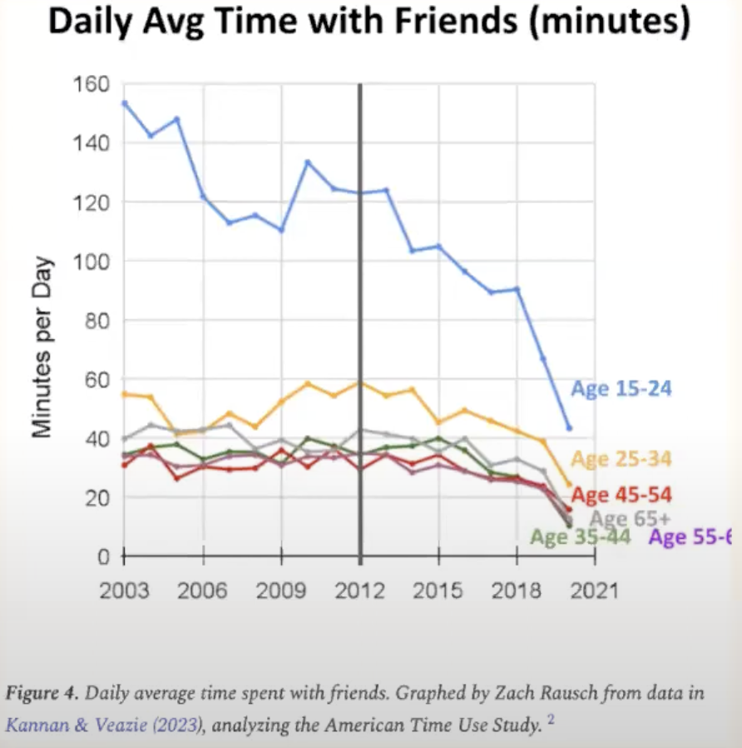
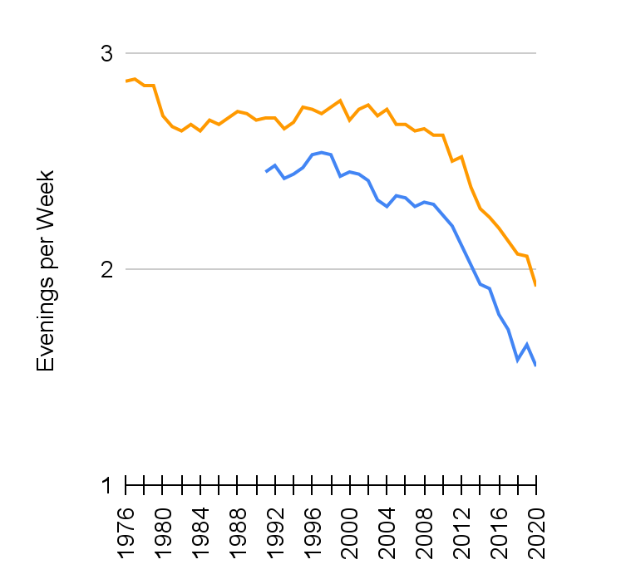
Teens who ‘meet up’ in the evenings
SOURCE: Monitoring the Future (MTF); Haidt & Rausch, The Anxious Generation, Online Supplement.
Notes:
Time with friends has been decreasing, with sharp declines following the increased availability of Social Media on smart phones (2012).

Slide 5
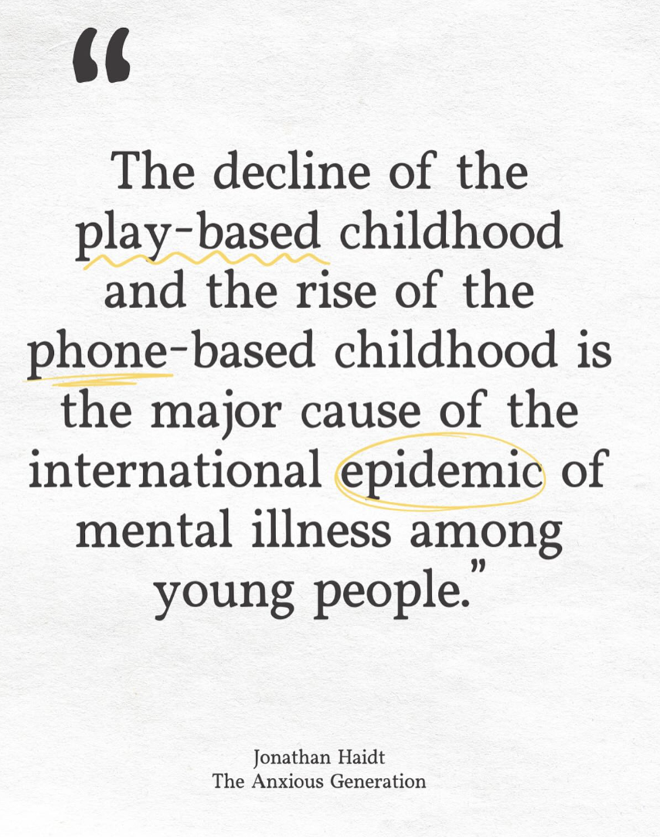
Rise of Play in Digital Worlds
About 75 percent of kids ages 9 to 12 regularly play the online game Roblox, where they can interact with friends and even strangers. Yet…
89% say that they aren’t allowed to be out in public at all without an adult
Fewer than half of the 8- and 9-year-olds have gone down a grocery-store aisle alone
More than a quarter aren’t allowed to play unsupervised even in their own front yard

Slide 6
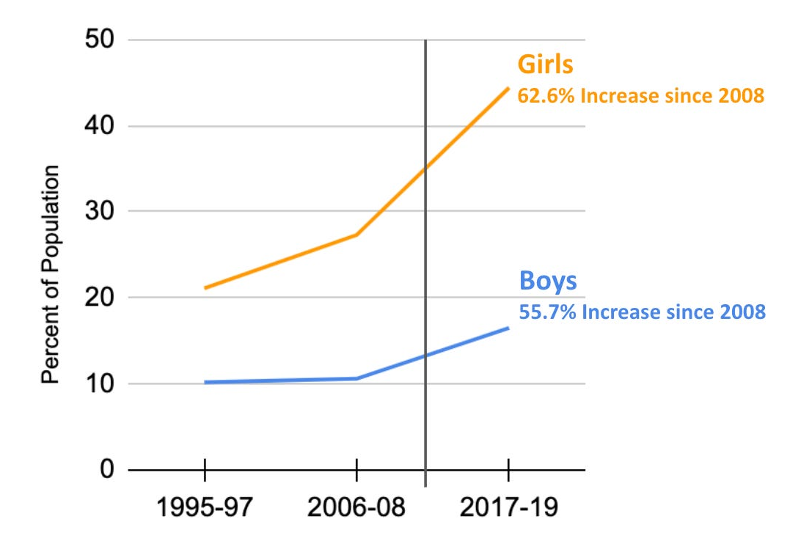
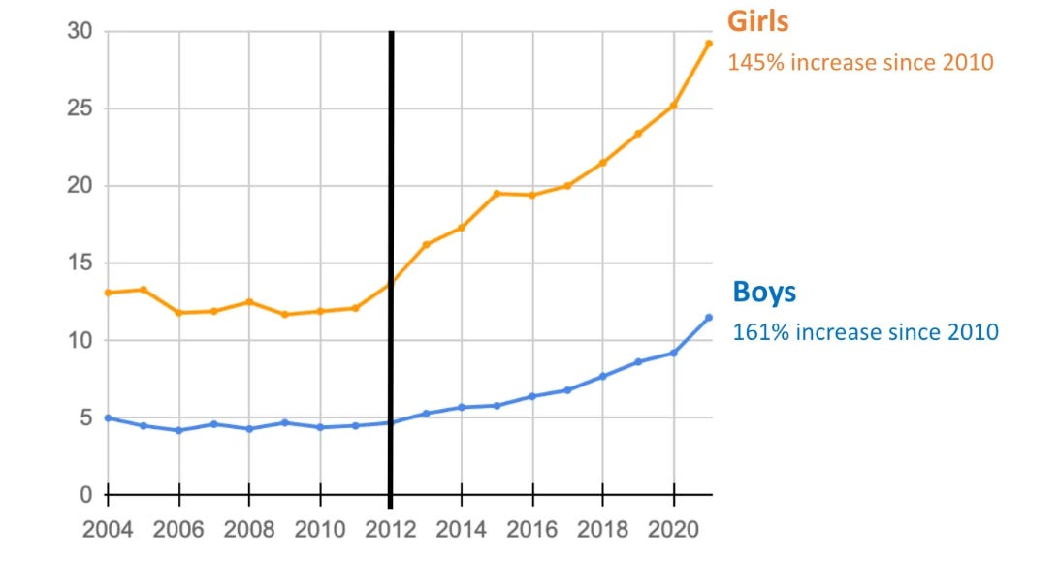
Mental Health “Hockey Stick”
Depressive Symptoms
Anxiety Symptoms
Rise of Social Media
Rise of Social Media
SOURCE: U.S. National Survey on Drug Use and Health; Haidt & Rausch (ongoing). The Anxious Generation, Online Supplement.
Notes:
Sharp increases of mental health concerns following the increased availability of Social Media on smart phones (2012).

Slide 7

The Current State of Screen Time
Children & teens spend a lot of time on screens! (American Academy of Child & Adolescent Psychiatry, 2024)
Children 8-12 years old in US spend 4-6 hours per day watching or using screens
Teens spend up to 9 hours per day
It is challenging to set limits on screens, and the pandemic made it harder…
59% of parents responded that they have become more permissive about internet use during the pandemic (https://www.morganstanley.com/articles/family-internet-use-survey)
Notes:
Children and teens spend a lot of time watching screens, smartphones, tablets, gaming consoles, TVs, and computers
On average, children ages 8-12 in US spend 4-6 hours per day watching or using screens; teens spend up to 9 hours (American Academy of Child & Adolescent Psychiatry, 2024)

Slide 8

Benefits of Digital Technology & Screen Time
Maintain social relationships
Practicing conversations over social media first
Help kids stay in touch with support networks
Help kids learn about themselves online
When consumed as a family…
Can increase a family’s feelings of connectedness (https://www.morganstanley.com/articles/family-internet-use-survey)
Shared positive experiences together
Being more flexible in their ability to schedule time together
Notes:
There are some great benefits to digital technology and screen time that we want to acknowledge!
Can help maintain social relationships
Practicing conversations over social media first
Help kids stay in touch with support networks
Help kids learn about themselves online
When consumed as a family…
Can increase a family’s feelings of connectedness (https://www.morganstanley.com/articles/family-internet-use-survey)
Shared positive experiences together
Being more flexible in their ability to schedule time together
Where we start to have challenges is when youth have access to devices without strong limit settings and boundaries and the risks begin to outweigh the benefits

Slide 9
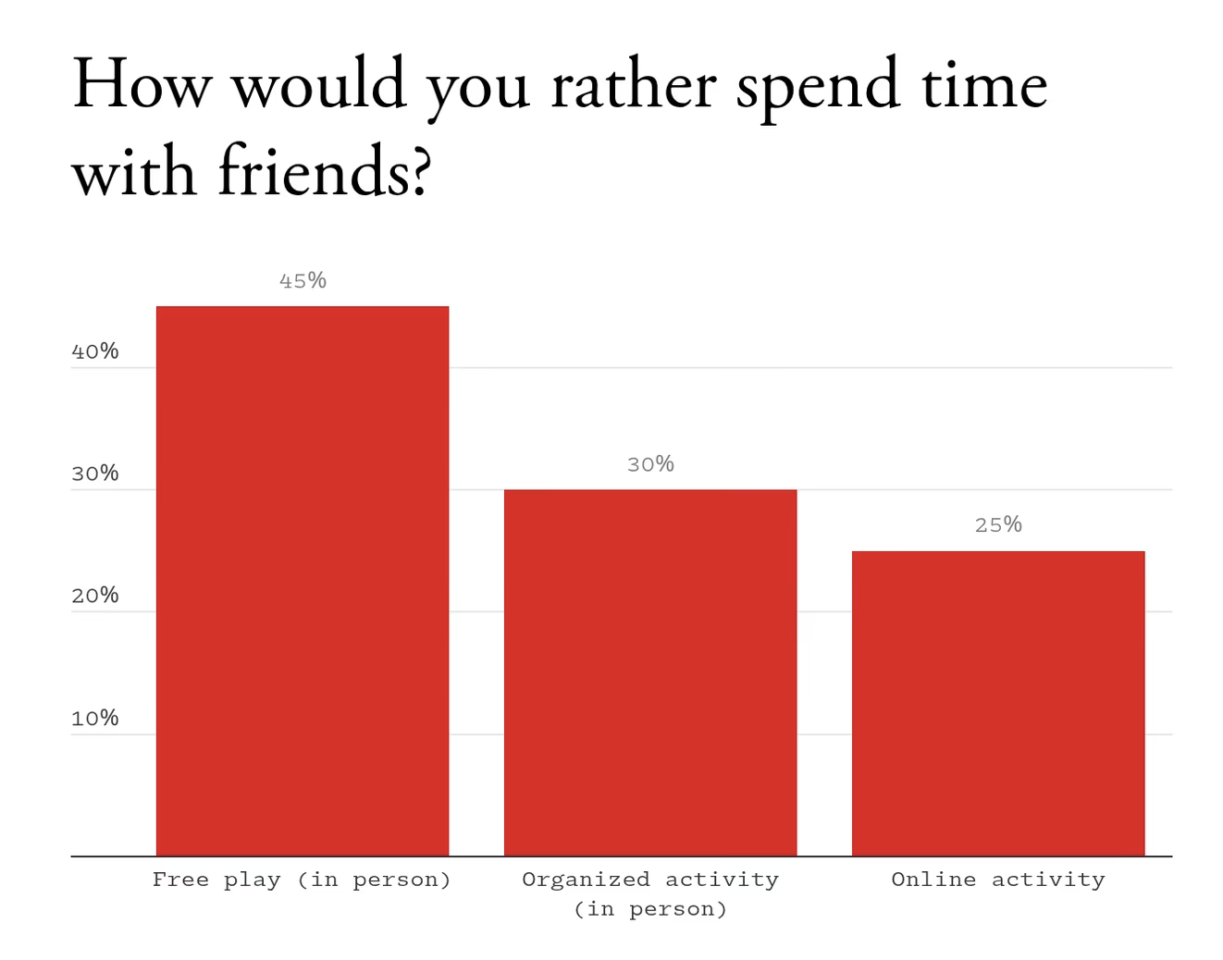
Notes:
We think that youth would rather spend all their time online but interestingly, when youth are asked: how would you rather spend time with friends? 45% says free play in person, 30% say organized activity in person and only 25% say online activity

Slide 10
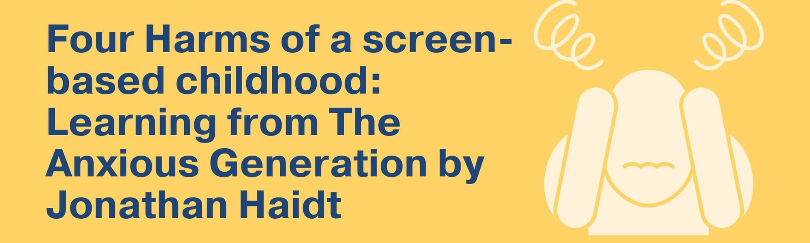
Social Deprivation
Sleep Deprivation
Attention Fragmentation
Addiction
Notes:
Social Deprivation: Unstructured play time- play is so important to kids’ development, last generation (gen z), born around 2010-2015, had access to smart phones and many kids missed a critical experience of playing with friends. Be creative, deal with that uncomfortable feeling of being bored, build that distress tolerance
Girls: more interested in relationships, social and gender differences- start early and go through life
Social media- you want to check in on what others are doing? What are others saying? Draws away from work, chronic social comparison- affect self-esteem
Relational aggression- bullying online; if a girl is depressed can make friends depressed because of social connectedness (less more boys), worse in middle school
Boys: more of a need for agency- out to build things, break tings, mechanical needs
Videogames say to boys- you want to break things? Fight? Here you go!
Sleep Deprivation- increases after 2014-2015
Some kids can handle having phone/tablet/TV/computer in their room this but most can’t
Kids struggle to go to sleep at night- exposure to blue light that messes with melatonin levels, revved up from videogaming or watching youtube clips; if device is in their room, might be waking up to play in the middle of the night or early in the morning
Attention Fragmentation & Distraction from homework
Kids are never far from their phone, often stop while doing homework/chore to check a message, take a quick social media break
Seems like they are “multi-tasking” but this actually makes it harder to focus- spend more time on homework because can’t concentrate and the product they create might be worse b/c they didn’t focus long enough to think about how best to do the assignment
Some kids, particularly kids with ADHD are especially vulnerable to tech distractions Tech use (phones, video games, tablets)
Why? Social media and phone apps and video games are purposefully created to be easy to focus on, offer immediate rewards
You might think- my kid can focus for hours on video gaming but can only focus for 10 minutes on homework- what’s up with this? Video game holds their attention, constant stimulation, they aren’t doing anything! With homework, with conversations at dinner table, with sitting through class lesson, the brain (prefrontal cortex) has to work hard to maintain attention- especially hard for kids with ADHD who struggle with EF skills; becomes harder when attention is distracted
Addiction
Behavioral addiction- social media companies literally copied los vegas- swipe down and see something new, is copied after slot machines

Slide 11

Ok… But is My Kid Spending Too Much Time on Screens?
Ask yourself what activities your child should be spending time on to be happy and healthy, examples:
Is my child sleeping enough and eating a somewhat balanced diet?
Are they getting some form of exercise every day?
Are they spending some quality time with family?
Do they keep in touch with friends?
Are they invested in school and keeping up with homework?
Do they spend time on the hobbies and extracurriculars that matter to them?
If Yes to most questions → probably an ok amount of screen time!
If lots of No’s → sign that you may need to set more limits around screen time
Child Mind Institute, 2024
Notes:
We Know the Recommended Hours but is my kid on screens too much?
Focus on what you want to make sure they are doing first rather than what they shouldn’t be doing
Try making a list of activities your child needs to spend time on in order to be happy and healthy… try asking yourself (Child Mind Institute):
Is my child sleeping enough and eating a somewhat balanced diet?
Are they getting some form of exercise every day?
Are they spending some quality time with family?
Do they keep in touch with friends?
Are they invested in school and keeping up with homework?
Do they spend time on the hobbies and extracurriculars that matter to them?
If most answers as yes, probably doing well with current screen time
If lots of no’s; if your child is spending most of their time alone, scrolling social media, spending so much time gaming that they aren’t eating or getting proper physical activity… sign that too much screen time

Slide 12
5 Cs of Media Use
Child
Who is your child, how do they react to media, and what are their motivations for using it?
Content
What is worth their attention?
Calm
How do they calm their emotions or go to sleep?
Crowding Out
What does media get in the way of?
Communication
How can you talk about media to raise a smart and responsible child?
American Academy of Pediatrics
Notes:
The American Academy of Pediatrics created the 5 C’s to guide media use for families, beyond the “2-hour screen rule”
The 5 C's of media use are based on the child, the content, ways to calm down, what media is crowding out and ongoing communication. 5 C's guidance for each age group starts with information about the developmental stages kids are going through and how this influences media use. It also describes healthy media habits to strive for at home. You can use these to build upon how you're already connecting with your kids.

Slide 13
Is My Child or Teen Ready for a Device? Am I Ready?
How do they respond when you set limits about other things?
Does your child have some ability to proceed with tasks independently without constant conflict?
Do we have a way to manage conversations about rules and expectations challenging situations (e.g., way to manage TV time, homework rules, sleepover rules)?
What is the purpose of why I am giving them a device? What is the right device to meet that need?
Am I ready to change rules around this phone/device when needed?
Notes:
Want to acknowledge how much pressure there is on parents these days to give their kids a phone, tablet, videogame/access to social media
Pressure often starts in late elementary school/early middle school
Parents don’t want their kids to feel left out; we also know that boundaries are critical and there are ways to meet those needs through other avenues
How do you know if they (and we) are ready (Child Mind Institute)?
How often does your child lose things? If you tell them something is extra important, do they take special care of it, or leave it on the bus?
Are they likely to say or do things they will regret? (phone)
How sensitive to criticism are they? (phone/social media)
Consider how easily your child picks up on social cues. If they are slow to catch on, this deficit could be aggravated in texting and posting on social media
How savvy is your child about technology? Do they truly understand that future college admissions staff, employers, and colleagues could conceivably see anything they post now?
How well does your child do with limits to screen time? If they are constantly glued to the computer or game console, they will probably have difficulty putting down the phone as well.
How do they respond when you set limits about other things?
Are you ready with your own expectations?
Ask yourself- what is the purpose of why I am giving them a phone/video game?
How can I make sure that they meet that need without it spilling over into other things?
What is the right device to meet that need?
Gabb phone?
If you think your kid is ready for a smartphone/tablet/videogame
it’s important they know that you are still in charge
Parents need to know their child or teen’s password, set clear rules, explain what happens if rules aren’t followed
Have everyone on same page is much easier
Benefits of delaying social media immersion:
Insure they will be more mature about what they post, more able to resist the addictive nature, less vulnerable to emotional harm
Raise your hand if you wished you gave your kids social media access sooner?
Most parents do not- but many say they are glad they waited

Slide 14
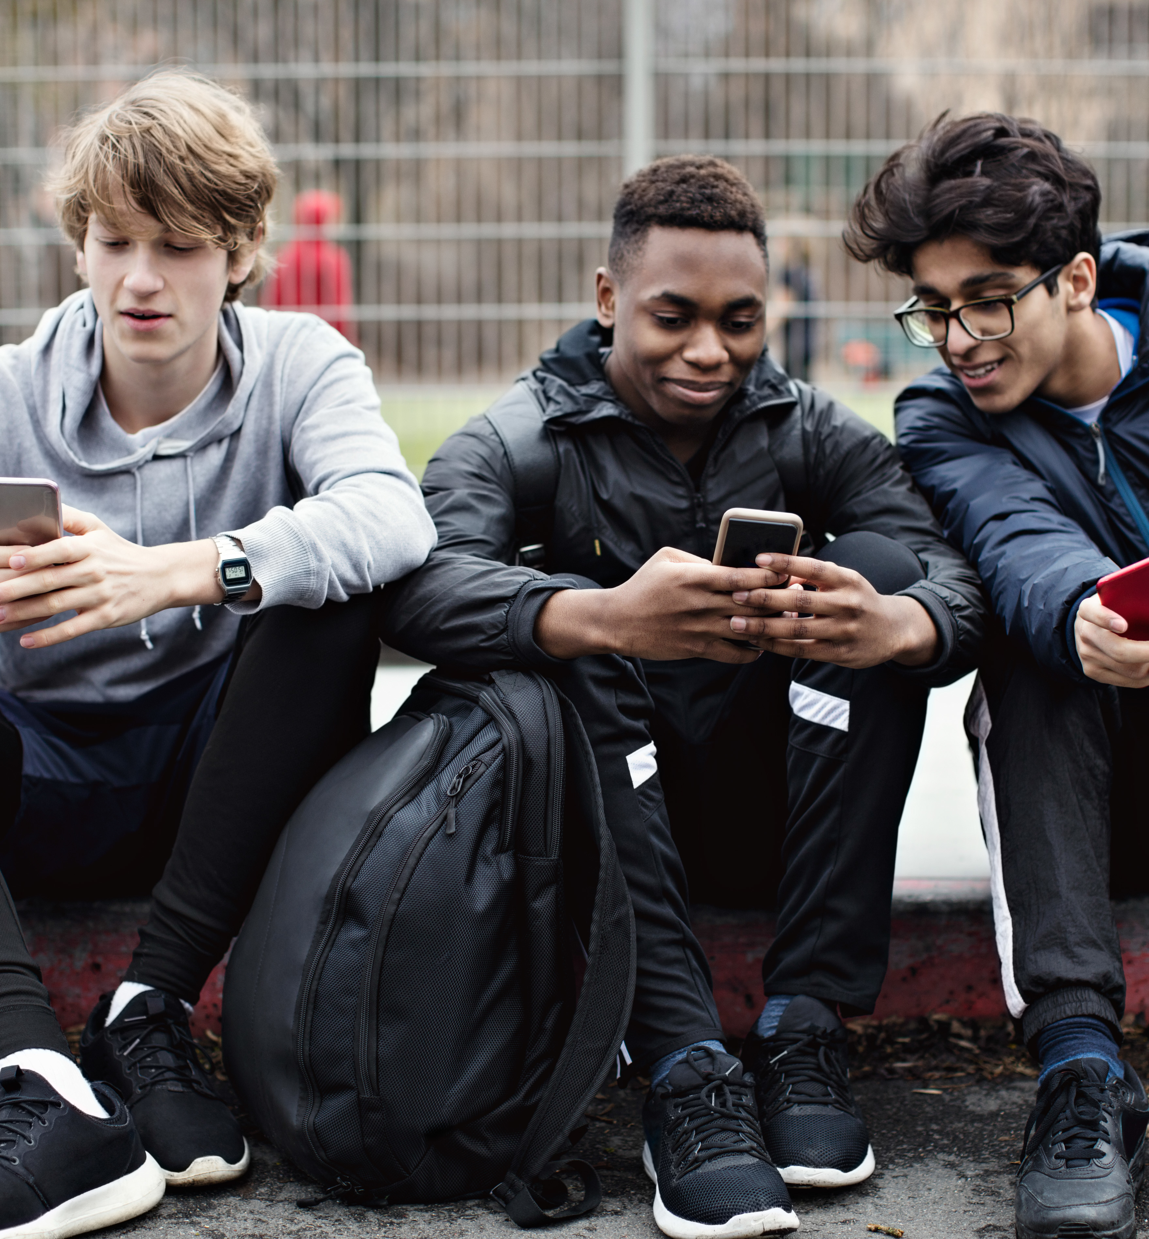
Approximately 2/3 of US children and adolescents report that their parents have “no rules” related to time spent on media use.
Kids and teens need help with screen time boundaries!
Brain development does not match skills needed to resist screens yet
Lack of impulse control
Screens are made to be addictive
Stronger sensitivity to immediate rewards
(Child Mind Institute, 2024)
Notes:
Approximately 2/3 of US children and adolescents report that their parents have “no rules” related to time spent on media use.
Yet, we cannot expect them to be able to create their own boundaries or resist the urge to be ”online” as much as possible:
Their brains are not developed enough to do it on their own; just having a talk with them isn’t likely to be effective
Kids/teens know that having a phone in their room while studying/doing homework is distracting, or that it keeps them up at night but they can’t help themselves (quite frankly, this is hard for most adults), so we need to help them
It may not seem like it but kids/teens want their parents to put up boundaries
During adolescent development, brain regions associated with the desire for attention, feedback, and reinforcement from peers become more sensitive. Meanwhile, the brain regions involved in self-control have not fully matured. (APA- https://www.apa.org/monitor/2023/09/protecting-teens-on-social-media)

Slide 15
Setting Boundaries for Your Child in General is hard! …but it’s not too late.
Be clear about expectations
Set the limit, validate the feelings & continue to hold firm
Your child WILL push back & have BIG feelings, this is normal!
Consider practicing setting boundaries around easier targets before introducing or changing screen time rules
Use logical/natural consequences (consider identifying these with your child)
Parenting is the long game
Notes:
General tips about setting boundaries
Your job is to set firm boundaries and validate their feelings and hold firm with that boundary
Your child/teen is going to react with big feelings and that is hard, exhausting as parent but it’s actually important, it’s your child’s job to do this so that they experience that frustration, disappointment, anger, and learn that they can handle it (this generalizes to other settings like limits/rules being set at school, like expectations or disappointments at future jobs); they look to you to see, can you handle it? Can we handle this?

Slide 16
Initial (or Re-Visited) Expectation Setting for Screens
Discuss the new or changed screen expectations with your child
How much time, when can they use it, where does it go at night?
Discuss parental controls & limits to privacy
Lead with compassion- we know it’s fun!
Anticipate the distressed response
Stick to the plan, tolerate their distress, pushback will fade, new routine stays
Avoid exceptions to rules in first few weeks
Allow screen time after responsibilities are completed
Screen time is a privilege that is earned, not a right!
Don’t get roped into a debate
State limit, validate their feelings, hold firm with limit, disengage
Child Mind Institute
Notes:
Parameters- Initial discussion around the device, how much time they can spend on it, where it goes when they aren’t allowed to use it, where it goes at night
Parents need to help their kids learn the do’s and don’t rather than just hoping they’ll figure it out
Put parental controls on and let them know, talk about it
Let them know that you may look at their phones
Not to get them in trouble, not to be sneaky but to make sure they are being safe and kind with their phone use
If you notice something, you’re going to have a discussion about it
Same thing as their room- my guess if most of you don’t allow your child to have a lock on the door and lock it all the times so you can never enter- you could enter if you wanted/needed to in order to make sure things are safe, etc. same thing applies here- not going in all the time but will plan to check in

Slide 17
Initial (or Re-Visited) Expectation Setting for Screens
Don’t feel guilty!
“None of my friends have limits on their video games!” “All my friends have TikTok!”
Your boundaries are there to keep them safe and healthy
Pick the right time
Consider changing rules when other things are changing, such as at the beginning of the week after a school vacation (not in the middle of a busy week!)
Make sure you have time to reinforce the rules
Gather Data & Re-Evaluate
Get older kids/teens to buy into new screen time rule by compromising, with the understanding that you’ll start with a trial run
Be Kind to yourself – and your kids
Child Mind Institute
Notes:
5. Don’t feel guilty!
“None of my friends have limits on their video games!” “All my friends have TikTok!”
Your boundaries are there to keep them safe and healthy
6. Pick the right time
Consider changing rules when other things are changing, such as at the beginning of the week after a school vacation (not in the middle of a busy week!)
Make sure you have time to reinforce the rules
7. Gather Data & Re-Evaluate
Get older kids/teens to buy into new screen time rule by compromising, with the understanding that you’ll start with experiment
Ex: your teen might be certain that screens after a specific time don’t affect their sleep; or that homework is easier while FaceTiming friends… consider trying their version and track how it goes for 2 weeks. Do they wake up on time in the morning? Did they get homework done? Use what you learn to readjust rules; if they can show you that they can reach the wellness goals, even as they engage with screens, that’s great
Be kind to yourself – and your kids
There’s no need to stick to rigid rules for the sake of perfection, and sometimes bending them is the most practical option. If more relaxed rules around screens give you time to work, exercise, or just take time for yourself, it’s okay to accept that that may be the best decision right now.
Dr. Anderson gives the example of wanting to limit your child’s TV time, even though one more episode would give you time for a workout. If you tell your child they can’t watch the episode, they’re cranky and you don’t get your workout. “In that case,” he says, “you can probably be more emotionally available if you give your child that extra screen time, take care of yourself, and then come together afterward.” Thinking in terms of everyone’s needs and stress levels (especially your own!) can help you set realistic limits that work in practice.

Slide 18

Strategies for Screen Limits
Be familiar with parental controls & put these on!
Limit apps, TV shows, movies, internet access, etc.
Start with less addictive/risky devices (e.g., Gabb Phone or specific videogames)
Set a clear schedule for when devices can/can’t be used
Emphasize using technology for connection (Facetiming friends/family) or for wellbeing (apps for mindfulness)

Slide 19

Strategies for Screen Limits
Increase your teen or child’s awareness of how they feel related to screens & why they use them
I noticed… did you notice that too?
Use media together to emphasize family connection
Family movie nights
Co-viewing media to connect and help kids/teens learn & discuss about topics that come up
Play apps/games together
Practice What You Preach
Modeling boundaries around devices!

Slide 20

Screen-free Zones
Keeping mealtimes screen-free
Keeping bedrooms screen-free at night
No texting/scrolling while driving
No devices on the way to and from school
Have a plan about devices at school- partner with schools to discuss what the plan and policies are
American Academy of Pediatrics

Slide 21

Screen-free Times
Specific days or times of day
Create a homework & screens plan
Use only 1 screen at a time
Avoid screens before school
Plan 1 screen free day a week (or part of a day)
Silence phones by putting on do not disturb during family time
Prevent screens from interfering with sleep
American Academy of Pediatrics

Slide 22
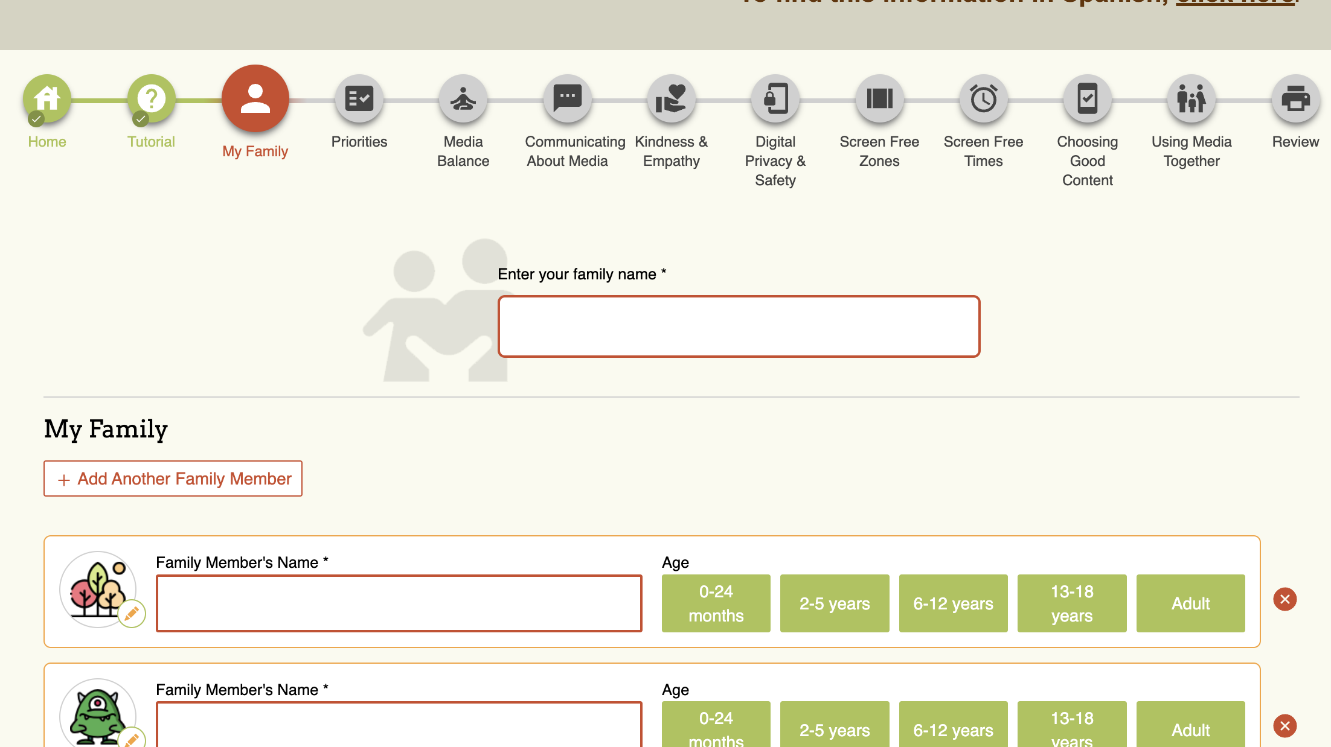
Create a Family Media Plan
www.healthychildren.org

Slide 23
Today’s kids want to spend their childhood in the real world. Let’s give it back to them. - Jonathan Haidt

Slide 24

Healing the Screen-Based Childhood
Kids and Families will need support at first!
Build tolerance of being bored & having less stimulation overtime
Brainstorm with your child/teen non-screen activities:
Reading, crafts, playing outside with neighbors, meeting up with friends for food, playing with the dog, doing board games, listening to music, etc.
Consider activities that you and other family members can do with your child
Recognize that your kids and teens may be using screen time to cope
Notes:
The New Jersey–based Balance Project is helping 50 communities reduce screen time and restore free play for kids, employing the “four new norms” that Jon lays out in The Anxious Generation.
This summer, Newburyport, Massachusetts, is handing out prizes each week to kids who try something new on their own.
(Let Grow has a tool kit for other communities that want to do the same.)
The Boy Scouts—now rebranded as Scouting America, and open to all young people—is finally growing again. We could go on.

Slide 25
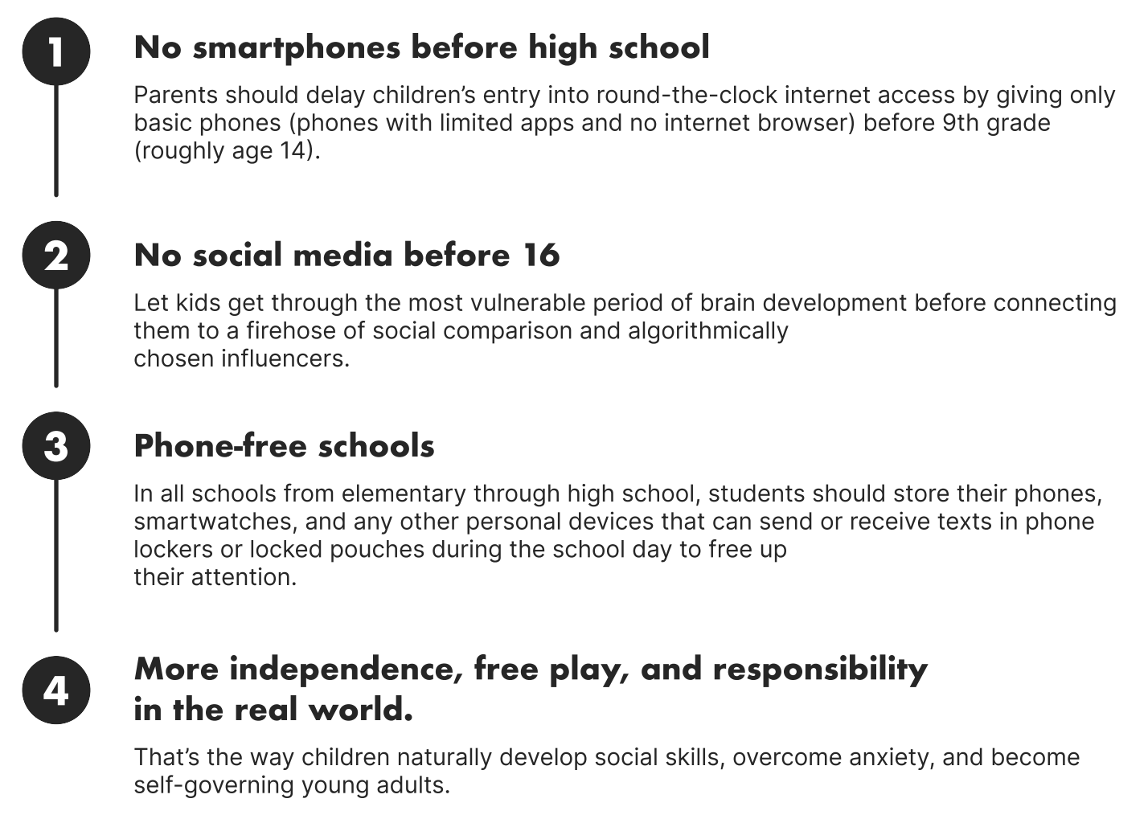
4 Norms
to Heal the Anxious Generation

Slide 26
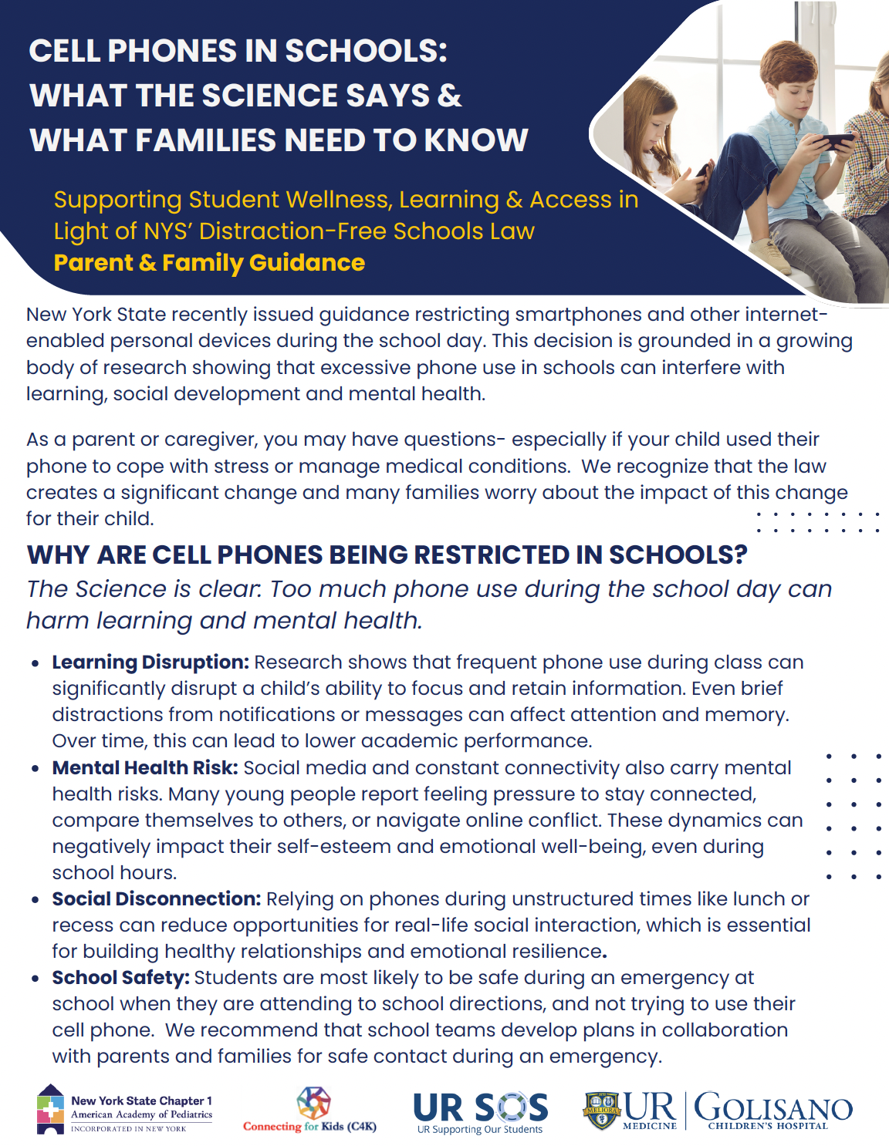
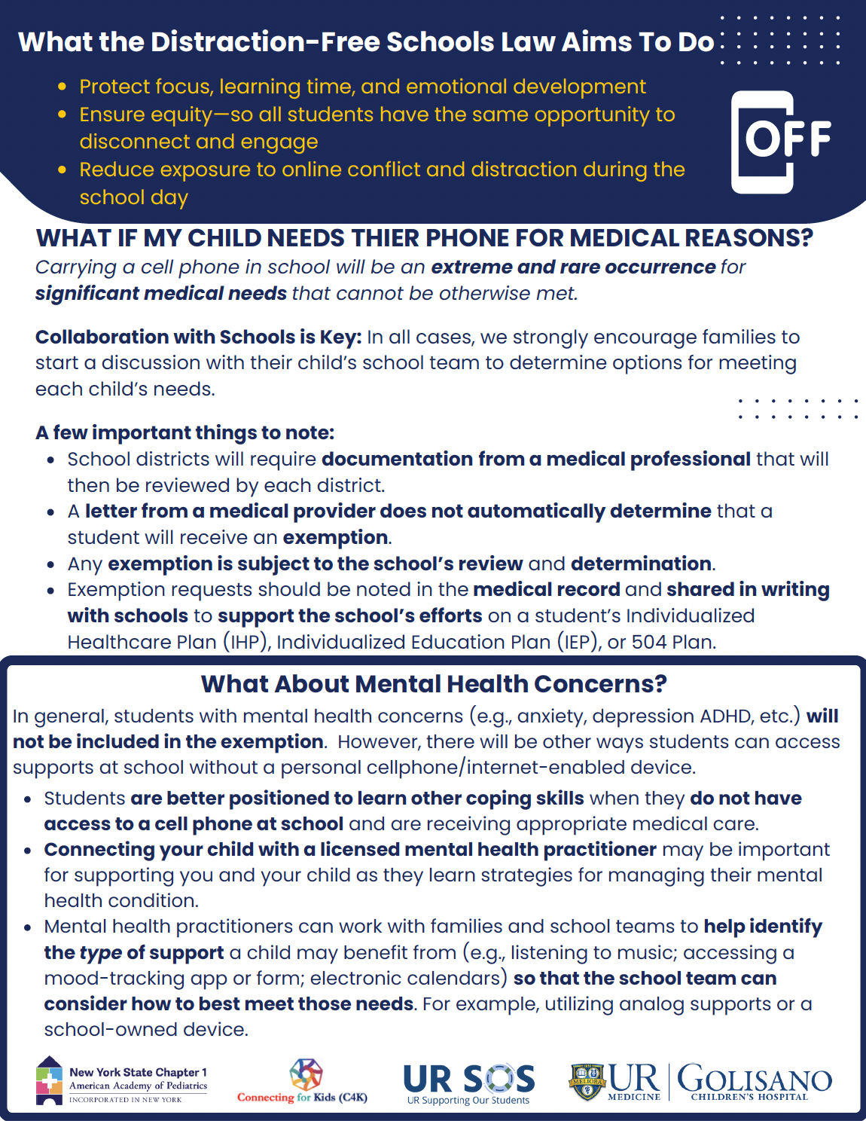
Parent Handouts
Notes:
In light of the NYS Distraction-Free Schools Law, we have resources to help families understand more about the law, the rationale behind it, exemption requirements, and ways to partner with schools

Slide 27
When to Get Additional Help
Impairment becomes daily, chronic, or severe – school, home, friends
When a family starts living life AROUND screens or related behavioral problems
The list of “things to avoid” grows, or the family is constantly on edge
It’s causing the family significant distress
Notes:
There also may come a point where getting additional support would be helpful
Signals that further support is needed include
Constant or severe impairment in daily live- school, friendships, family life
When you’re living around anxiety
When there’s a long list of things to avoid and it keeps growing
If it’s causing significant distress in the family or for your child

Slide 28
What Additional Help is Out There?
Therapy with a mental health clinician
Help create and implement attendance plan
Support your child with managing anxiety or other mental health challenges, if applicable
Medication management of mental health problems (anxiety, depression, ADHD) through primary care provider or psychiatrist
Notes:
What additional support is available?
Connecting with a mental health clinician for therapy for your child and family
Help create and implement attendance plan;
make suer appropriate goals,
Make sure nothing reinforcing accidentally
Help manage anxiety or other mental health challenges if applicable
May also consider medication management with pediatrician or psychiatrist
Lastly, may consider

Slide 29


Pediatric Behavioral Health Resources in Monroe County
What are the options if the student in crisis?
Person-In-Crisis & Mobile Crisis Teams: 2 -1 -1 (Life line)
UR Medicine: Brighter Days Mental Health Urgent Care (585) 275-8686 (12 – 7, 7 days/week)
UR Medicine: Comprehensive Psychiatric Emergency Program (CPEP) (9-1-1)
Local emergency department (e.g., RGH, Clifton Springs, etc.)
What are the options if a student needs help but is not in a crisis?
Help Lines
UR Med Crisis Call Line (24 Hours)- (Can call even if not a patient)
(585) 275-8686
National Suicide Prevention Hotline (24 Hours)
9-8-8 or online chat platform @ https://suicidepreventionlifeline.org/chat/
National Parent Helpline
Available Monday through Friday, 1-10 pm @ 855-427-2736
Crisis Text Line (24 hours)
Text MHA to 741741, and you will be connected to a trained Crisis Counselor
Trevor Project (24 hours)
Suicide hotline: 1-866-488-7386
TrevorChat: https://www.thetrevorproject.org/get-help-now/
TrevorText: Text START to 678678
Behavioral Health Therapy Supports
Rochester Regional Health: Genesee Mental Health Center (GMHC)* - 585-922-7770
Liberty Resource Behavioral Health* - (585) 410-3370
UR Medicine: Pediatric Behavioral Health & Wellness (PBH&W) Outpatient Services - 585-279-7800
Catholic Family Center (CFC) - 585-546-7220
Villa of Hope Behavioral Health Clinic - 585-328-0834
Family Access & Connection Team (FACT) - 585-753-2639, https://www.monroecounty.gov/hs-fact-far
Finding Private Practitioners - www.psychologytoday.com or www.therapyden.com
* Often has walk-in hours available – call ahead for hours

Slide 30



AAP Center for Excellence in Social Media and Youth Mental Health
AAP 5 Cs of Media Use: A series of age-based handouts to give to parents at well-child visits and other public health engagements in the link above.
AAP Family Media Plan: A customizable tool to help families establish media and technology rules that reflect their values and fit their lifestyle.
AAP Tips and Strategies for Safe Media Use
Problematic social media use: When PMU is identified, tailored interventions like therapy (e.g. CBT or DBT), parental psychoeducation, and structured limits around media use may be needed.

Slide 31
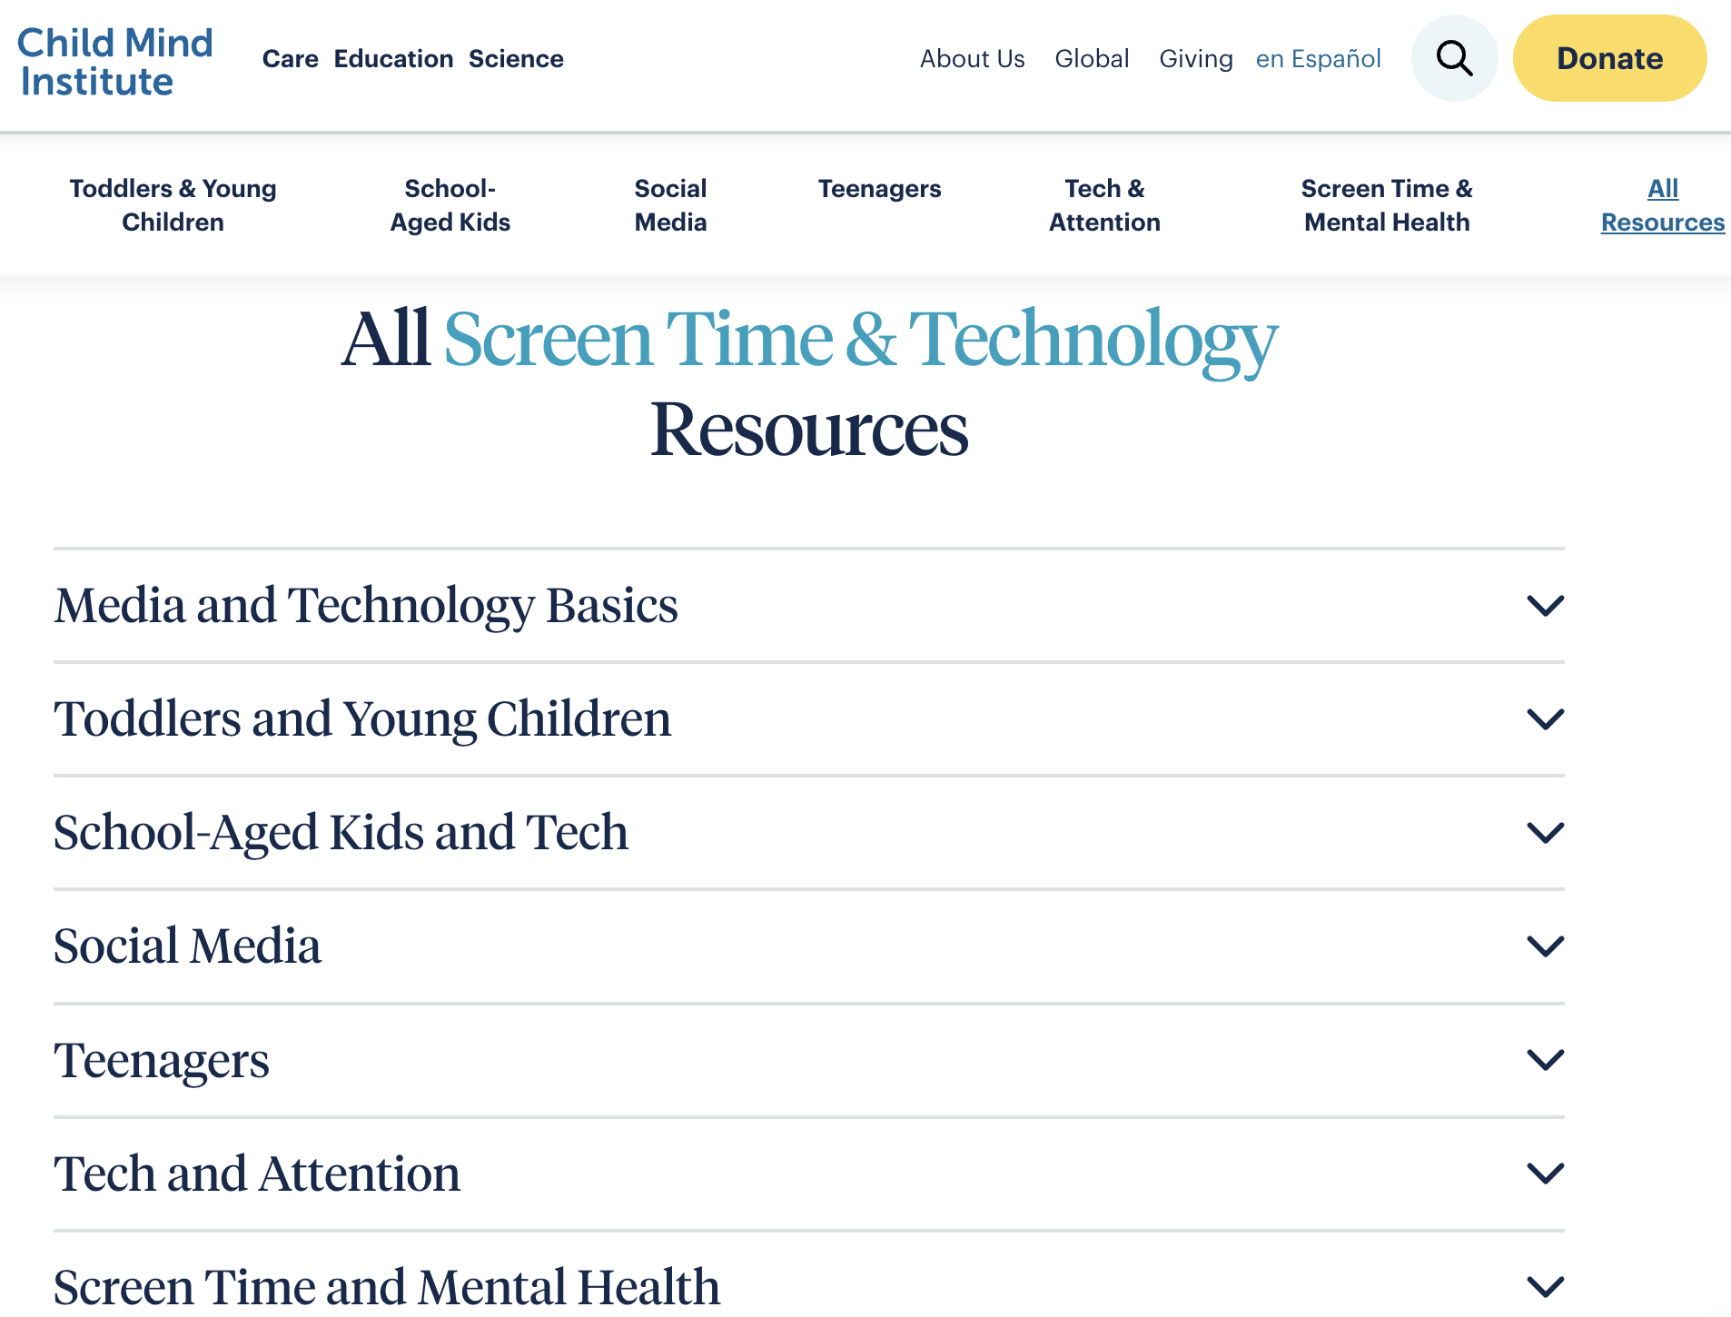
Child Mind Institute: Screen Time & Technology Resources
How to help kids stop comparing themselves on social media
Pause and Reset: A Parent’s Guide to Preventing and Overcoming Problems With Gaming by Nancy M. Petry, PhD
Parent/Caregiver’s Guide to Instagram
Wait Until 8th
The Anxious Generation by Jonathan Haidt
Notes:
Roch mh better days ahead
Fact
Peer success online- ask colleagues

Slide 32

Final Thoughts

